Slide 1

An Experimental Study of What Makes Deep Neural Networks Generalize Well
- The Role of Regularization
Using Fashion MNIST
Neha Thonta (nt446)
Ganesh Raj Kyatham (grk62)
Manisha Gayatri Damera (md1723)

Slide 2
Introduction
Key feature of deep neural networks is their capacity for memorizing large amounts of data. This capacity for memorization can also lead to overfitting.
Generalization Error: It is a measure of how well a machine learning model performs on new, unseen data.
Deep neural networks have been observed to achieve 0 training error even when trained on completely random labels, highlights the importance of controlling generalization error.
Controlling generalization error can be challenging due to their large number of parameters that can be tuned to fit the training data very closely.

Slide 3
Motivation
What is it that distinguishes neural networks that generalize well from those that don’t?
Paper summary
Despite their massive size, successful deep neural networks can exhibit a remarkably small difference between training and test performance.
Importance of controlling generalization error in deep neural networks, but notes that explicit forms of regularization are not always necessary for good performance.
Performed image classification using different deep neural networks to analyze their generalization performance and gain a better understanding.

Slide 4
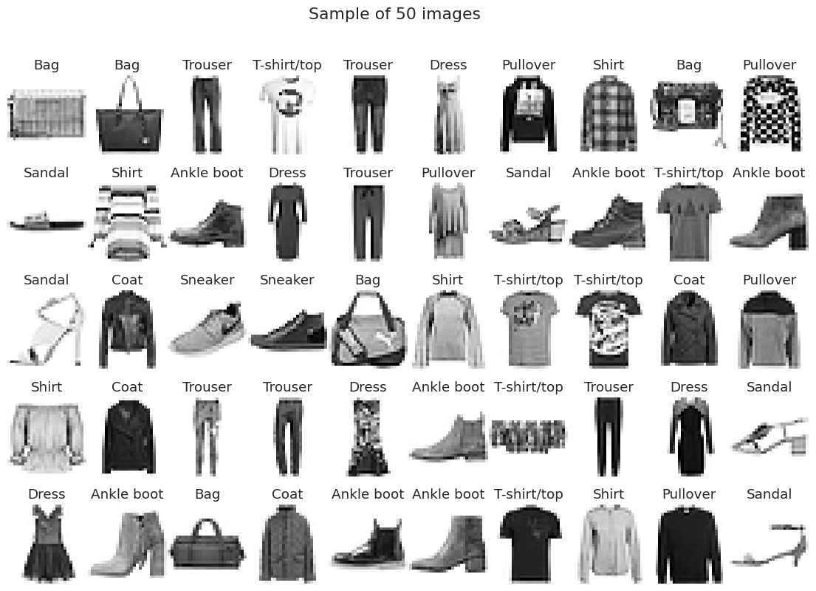
Dataset - Fashion MNIST
The Fashion MNIST dataset is a collection of 70,000 grayscale images of fashion items,
including 10 different categories such as t-shirts, dresses, sneakers, and sandals.
0 - T-shirt/top
1 - Trouser
2 - Pullover
3 - Dress
4 - Coat
5 - Sandal
6 - Shirt
7 - Sneaker
8 - Bag
9 - Ankle boot

Slide 5
Deep Neural Network Models
01
02
03
MODELS IMPLEMENTED
MLP
CNN
VGG16
Feedforward artificial neural network, used for Regression and Classification.
Deep learning architecture for Image Analysis.
Deep convolutional neural network architecture for Image Recognition.

Slide 6
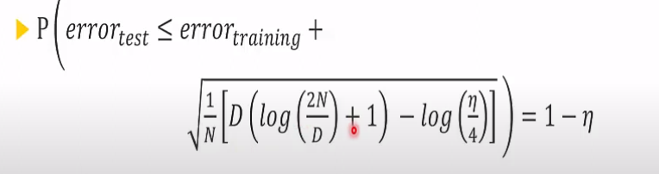
Vapnik-Chervonenkis theory, VC Dimension
The VC dimension of a model is the maximum number of datapoints that can be arranged so that f shatters them
This upper bound is valid when D<<N. Fails for neural networks where D >> N

Slide 7
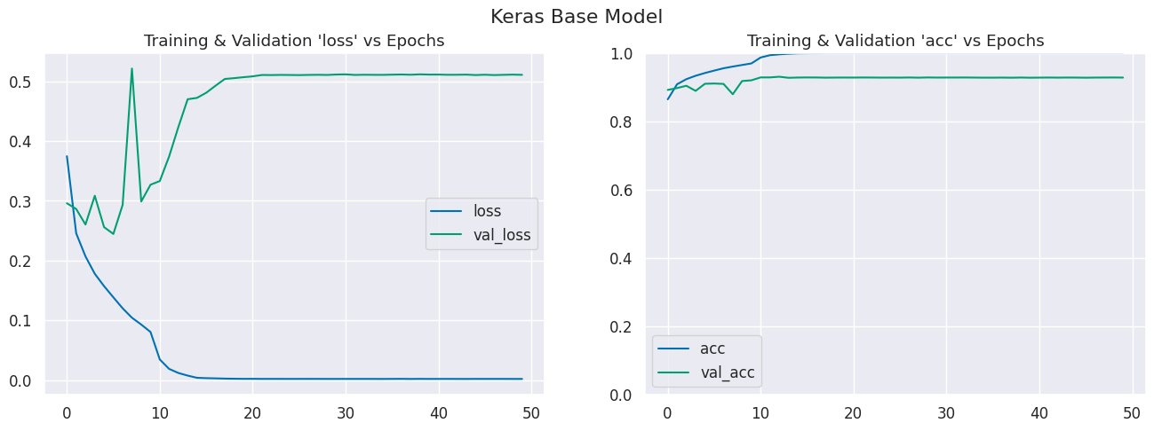
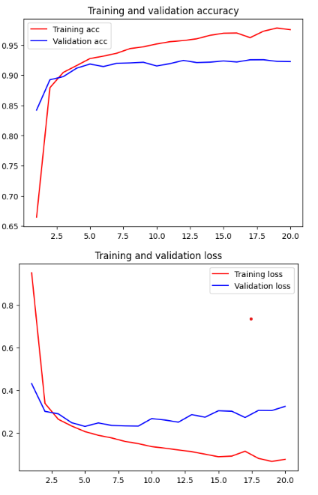
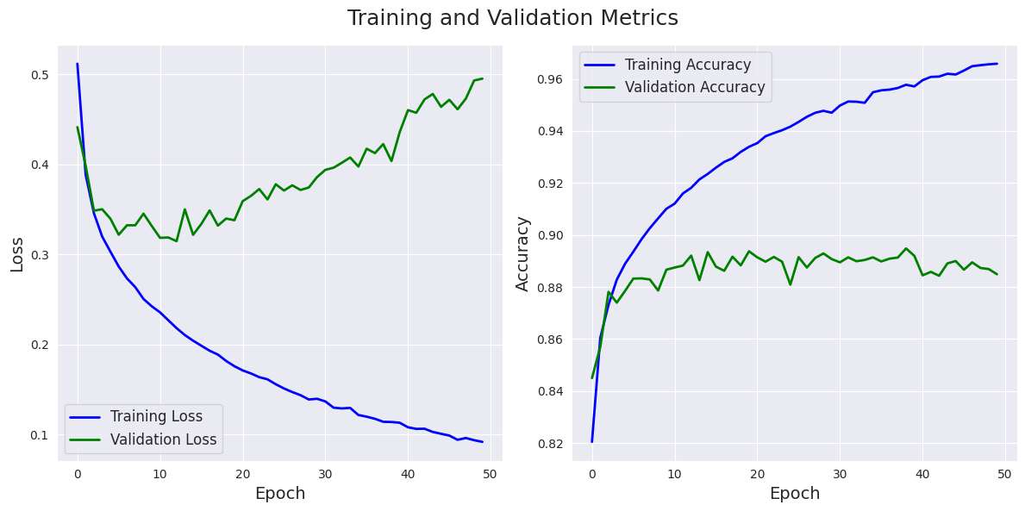
Without Regularization
CNN
VGG16
MLP

Slide 8
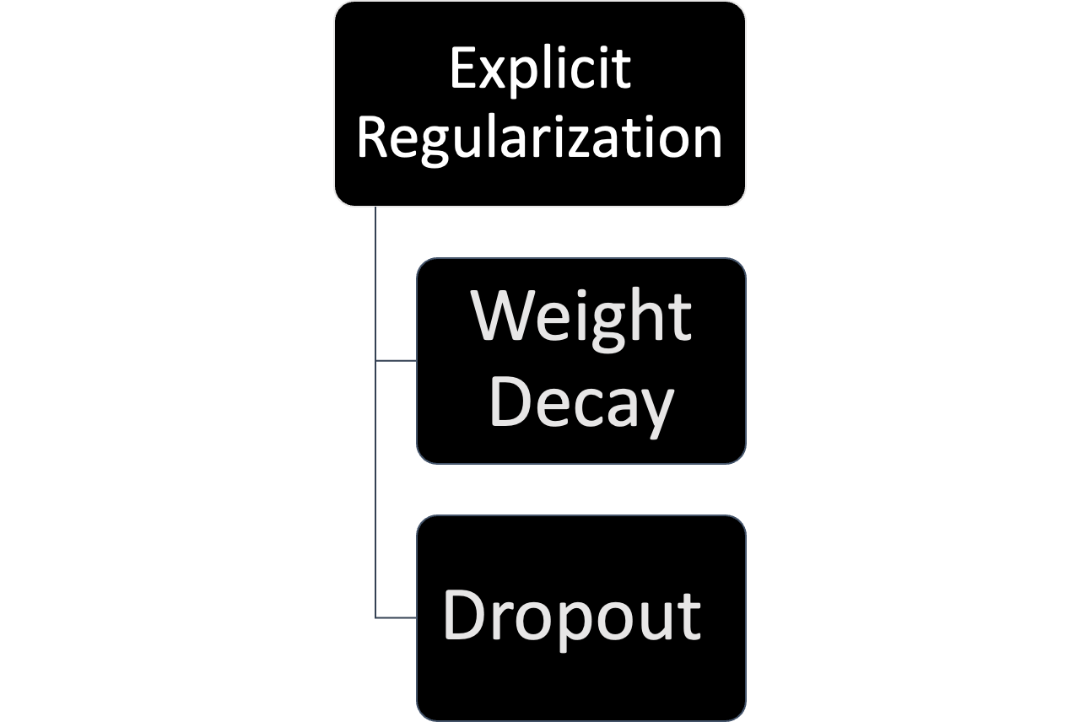
Regularization
Regularization refers to a set of different techniques that lower the complexity of a neural network in order to prevent overfitting
Neural networks easily fit most of the data given to them
Most common explicit regularization techniques are dropout and weight decay.
Reduce the effective capacity of the model and typically require the use of deeper and wider architectures to compensate for the reduced capacity

Slide 9
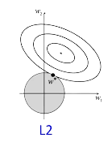
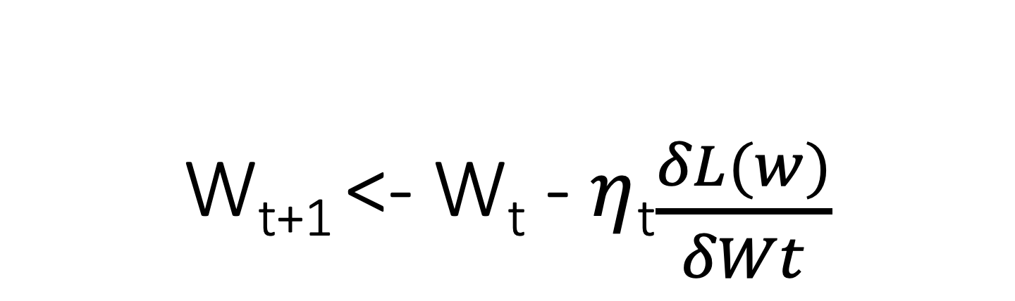
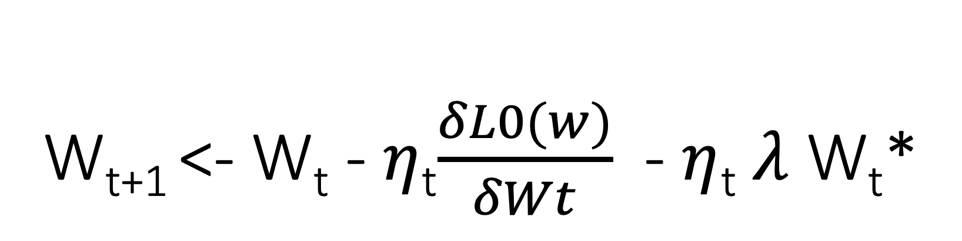
L2 Regularization (Weight Decay)
Works at reducing overfitting
Standard weight update:
L(W) = L₀ (W) + λ/2 w² *
New weight update:
Forces the weights to become small “decay”

Slide 10
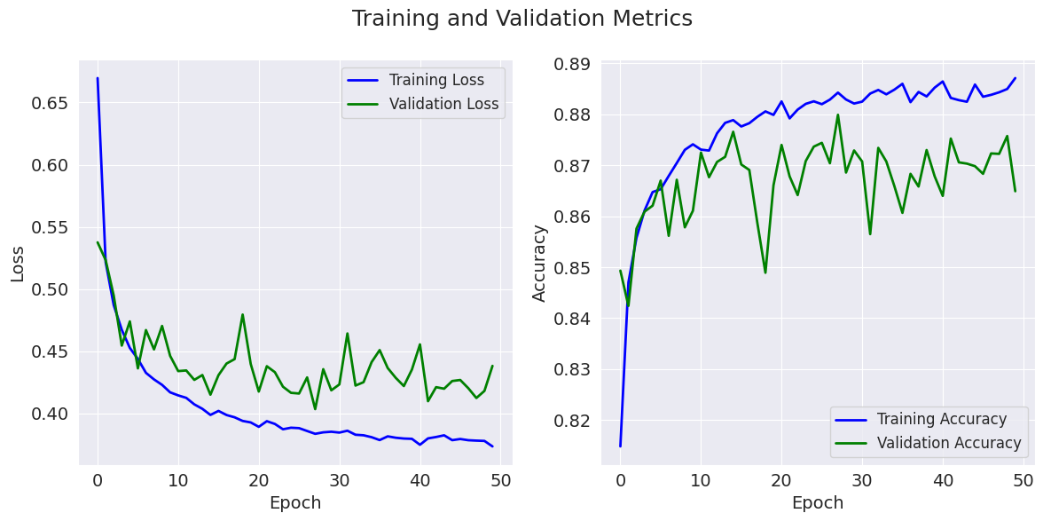
Weight Decay - Results
MLP

Slide 11
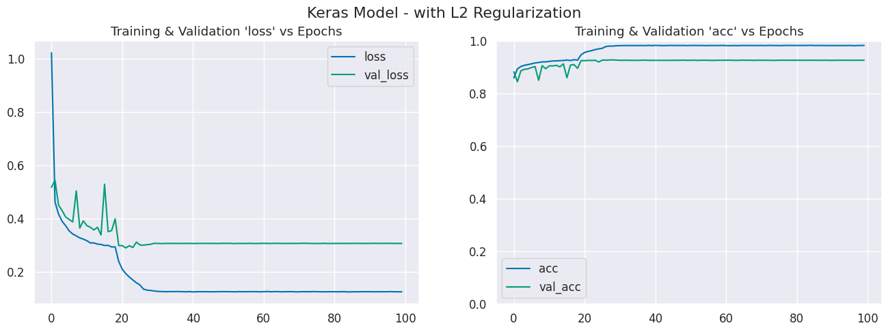
Weight Decay - Results
CNN

Slide 12
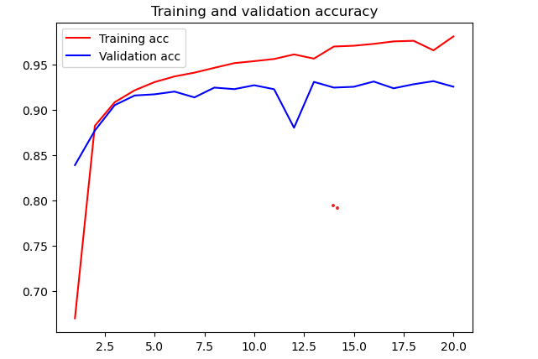
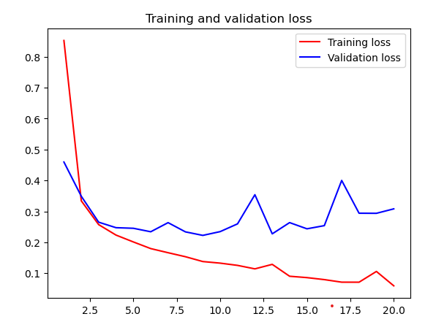
Weight decay - Results
VGG16 - ImageNet

Slide 13
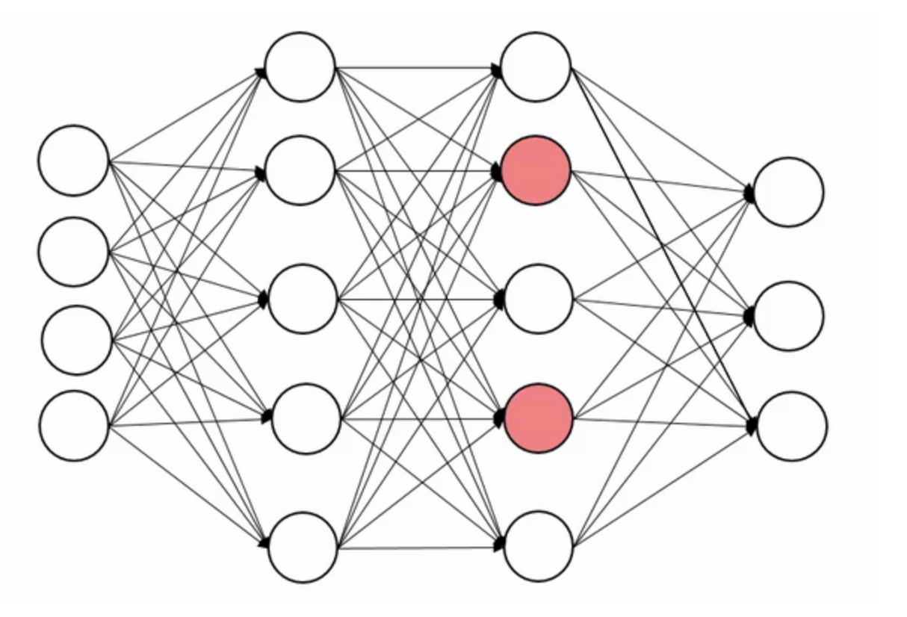
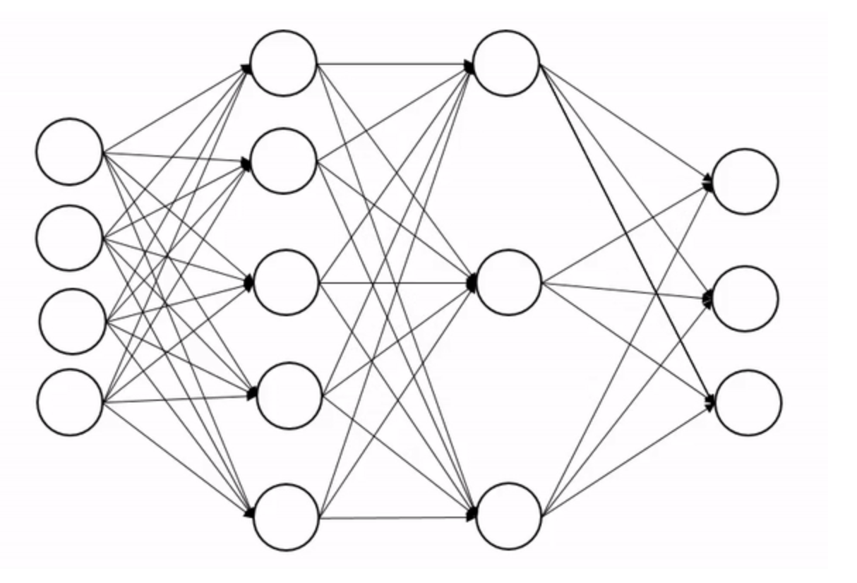
Dropout
Randomly drop neurons from layers in the network
Removes reliance on individual neurons
Learn Redundancies
Learn more nuanced set of feature detectors
Mask out each element of a layer output randomly with a given dropout probability.

Slide 14
Dropout Regularization - Results
MLP

Slide 15
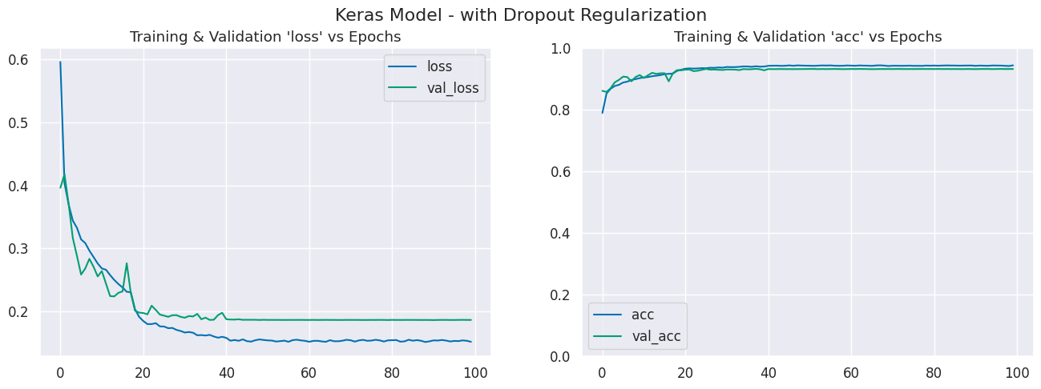
Dropout Regularization - Results
CNN

Slide 16
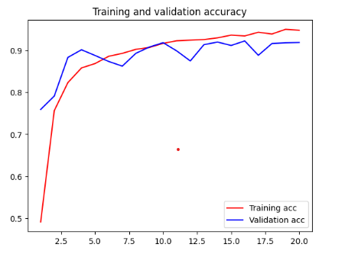
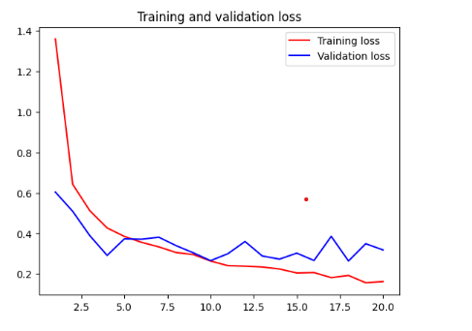
Dropout Regularization - Results
VGG16 - ImageNet

Slide 17
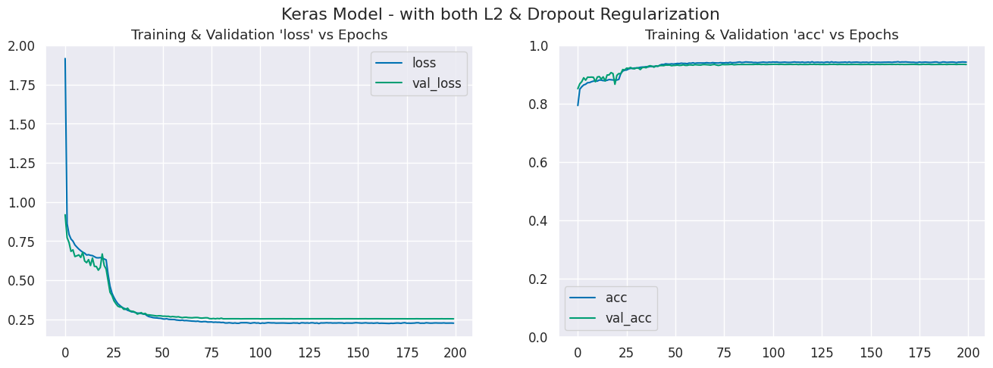
Weight Decay & Dropout Regularization - Results
CNN

Slide 18
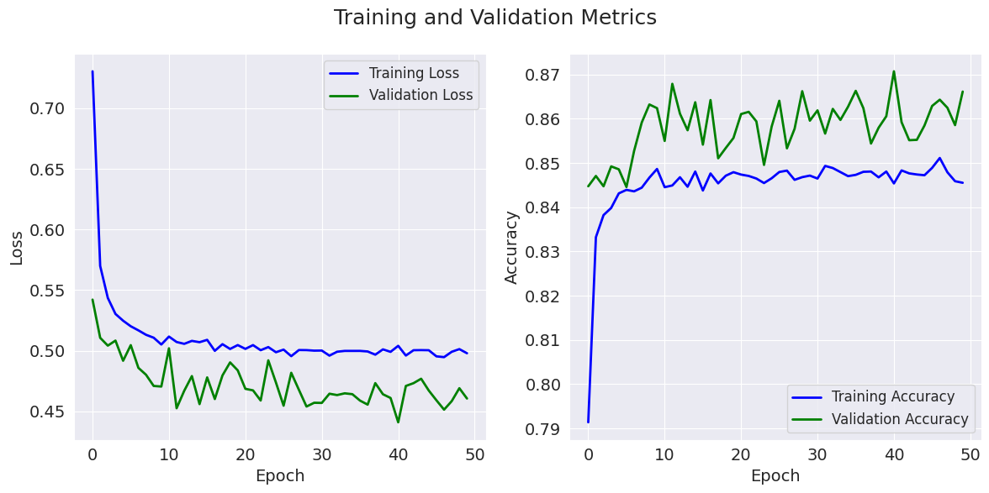
Weight Decay & Dropout Regularization - Results
MLP

Slide 19
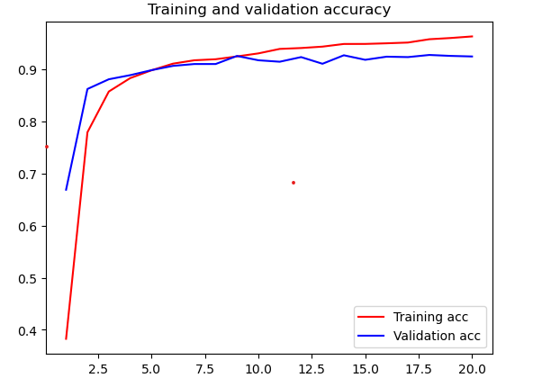
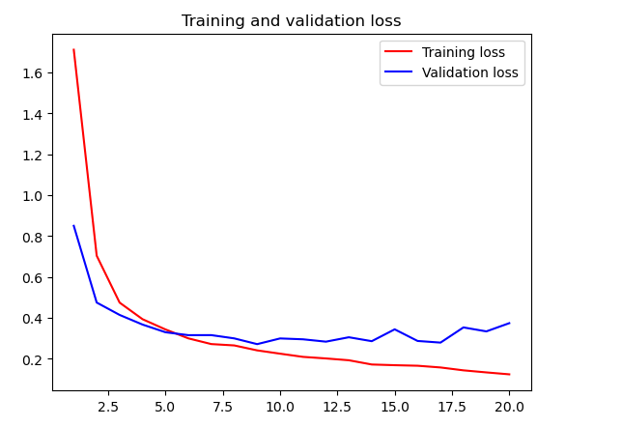
Weight Decay & Dropout Regularization - Results
VGG16 - ImageNet

Slide 20
Model | L2 Regularization | Dro- pout | Train Accuracy | Test Accuracy
MLP | No Yes No yes | No No Yes Yes | 96.6 88.7 84.5 82.4 | 88.5 85.8 85.3 84.5
CNN | No Yes No Yes | No No Yes Yes | 100 98.4 96.2 96.3 | 92.8 92.6 93.2 93.4
VGG16 | No Yes No Yes | No No Yes Yes | 97.5 98.1 94.7 96.3 | 92.2 92.5 91.8 92.5

Slide 21
Conclusion & Implications
The study demonstrates the effect of explicit regularization methods like weight decay, and dropout performed on the MNIST datasets.
Bigger gains by changing the model architecture.
The effective capacity of neural networks is sufficient for memorizing the entire dataset
Explicit forms of regularization, such as weight decay and dropout, may improve generalization performance, they are not always necessary for good performance.

Slide 22
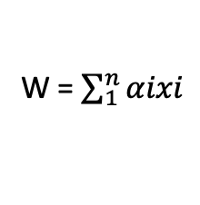




Implicit Regularization - SGD
Implicit Regularization: When the algorithm itself is implicitly regularizing the solution to converge to certain minima while avoiding others.
Stochastic Gradient Descent
Given SGD : and , then for some coefficients α.
Lies in the span of the data points.
To get a perfect fit on labels, using kernel matrix and solving to get the minimum L2 norm.
Hence SGD converges to the solution with minimum norm

Slide 23
Final Conclusion
Neural networks have effective capacity and are large enough to shatter training data.
Traditional measures of model complexity struggle to explain the generalization of large neural network.
Optimization continues to be easy even when generalization is poor.
Both explicit and implicit regularizers could help to improve the generalization performance.
However, it is unlikely that the regularizers are the fundamental reason for generalization.

Slide 24
Thank You

